Slide 1



Partnership for Research and Education in Materials
Webinar
2018 PREM Solicitation
October 2017
Dr. Eva M. Campo
Division of Materials Research Program Directors
National Science Foundation

Slide 2

Description
Contents
  Program Context and Mission
  Historic overview
  Characteristics of this solicitation:
      Framework
      Pathway
      Elements of a PREM
  Presentations by selected current PREM PIs
  NSF expectations:
      Metrics of success
  Contacts
Follow up: (off-line) Q&A
Notes:
This webinar is designed to inform the scientific community about the main characteristics of the NSF-17-599 PREM solicitation at Division for Materials Research (DMR), which invites Minority Serving Institutions (MSIs) to submit proposals before the deadline of Jan 29, 2018

Slide 3
Context
From ‘NSF_big_ideas’
The U.S. is experiencing a period of significant demographic shifts; the Census Bureau projects that by 2050, minorities will comprise 53 percent of the population (31% today)
To maintain U.S. leadership in science, the nation must address the challenge of broadening participation in STEM within a single generation
The PREM program is the DMR response to that call

Slide 4
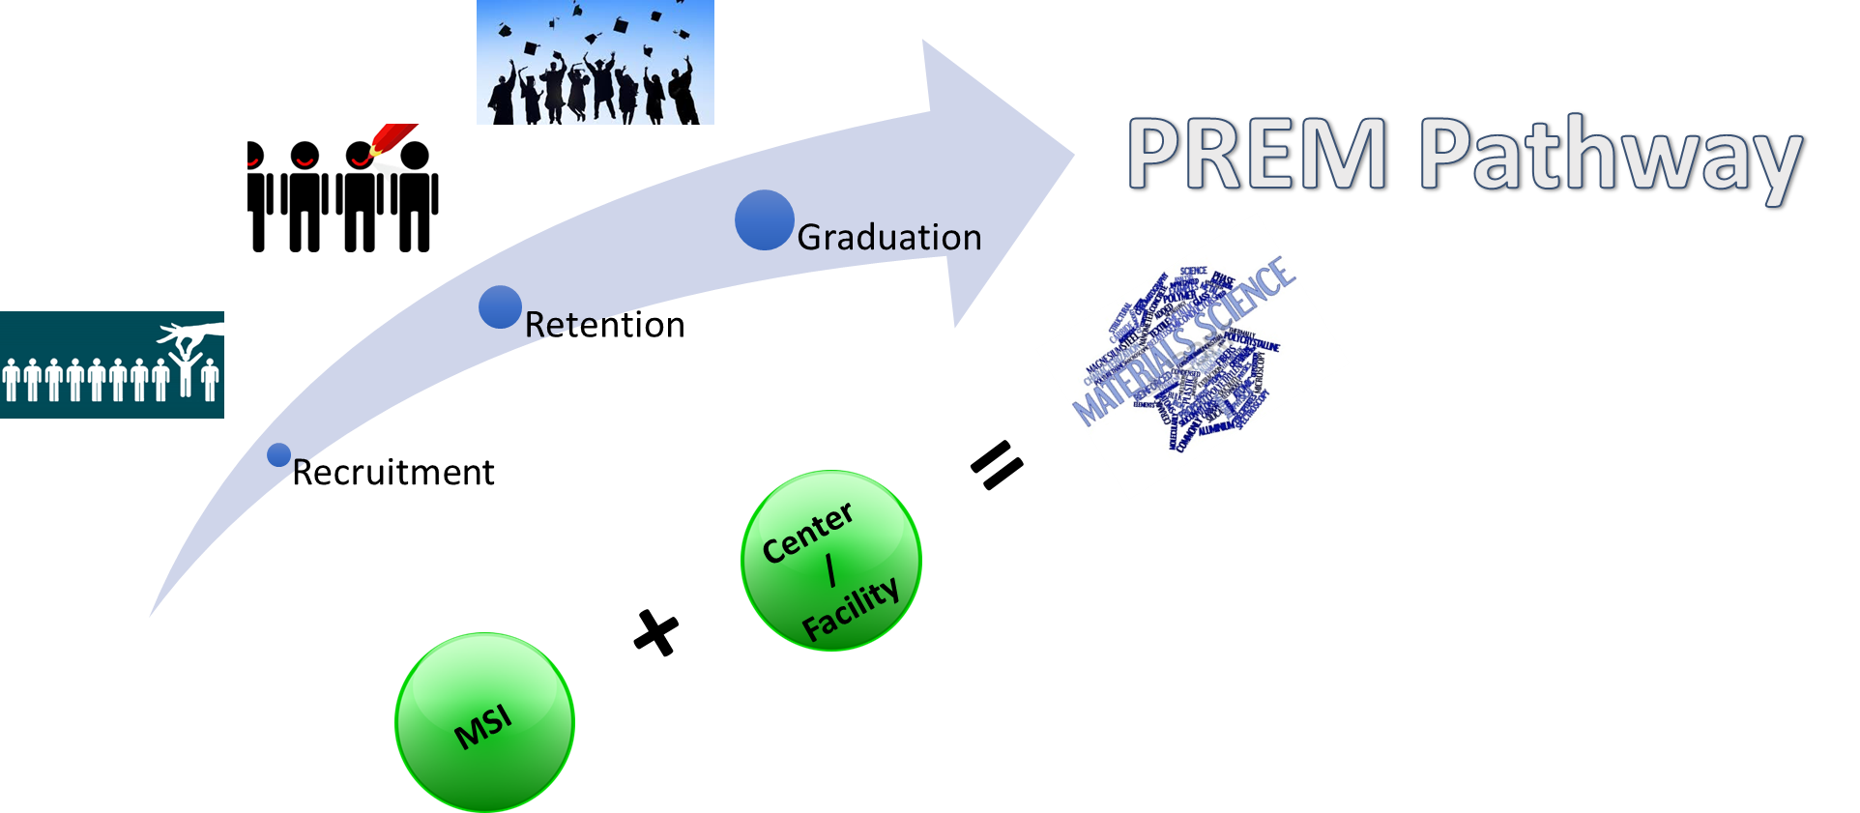
Mission
The PREM program aims to:
Enable, build, and grow partnerships between minority-serving institutions (MSI) and DMR-supported centers and/or facilities to increase:
  recruitment
  retention
  degree attainment
  by members of those groups most underrepresented in materials research.
Support excellent research and education endeavors that strengthen such partnerships.

Slide 5
PREM-Relevance to NSF Mission*
"a Nation that creates and exploits new concepts in science and engineering and provides global leadership in research and education"
    research excellence,
    inclusiveness, and
    learning
NSF strategic goals:
TRANSFORM THE FRONTIERS OF SCIENCE:
Seamless integration of research and education as well as the close coupling of research infrastructure and discovery:
T-1: Make investments that lead to emerging new fields of science and engineering and shifts in existing fields.
T-2: Prepare and engage a diverse STEM workforce motivated to participate at the frontiers.
B. INNOVATE FOR SOCIETY
C. PERFORM AS A MODEL ORGANIZATION
* NSF's strategic plan (https://www.nsf.gov/pubs/2014/nsf14043/nsf14043.pdf)
Notes:
The NSF vision of …..
encompasses the core values* of ……………
With 3 interrelated …….

Slide 6
PREM-Program History
Competitive research awards to minority serving institutions (MSIs)
  Interdisciplinary materials research teams at both institutions.
  Multi-level education programs to enhance diversity of students interested in materials science.
  Partnership based on intellectual connections.
5 Competitions to date: 2004, 2006, 2009, 2012, 2015
30 Awards to date, 12 currently active
  ~ 600k/year for 5 years
  Co-funding from CREST, HBCU-UP, EPSCoR, OMA, DMS
New competition opened 09/2017; deadline Jan29 2018
  $300,000 to $700,000/year for up to a period of 6 years
  https://www.nsf.gov/funding/pgm_summ.jsp?pims_id=5439
Notes:
6 new PREMs in 06:
Cal State Northridge / Princeton
Jackson State /UCSB
Norfolk State / Cornell
Howard / JHU
Tuskegee / Cornell
UNM / Harvard

Slide 7
Other NSF Initiatives for MSIs
Partnerships in Astronomy & Astrophysics Research and Education (PAARE). Similar to DMR PREM, in AST
Centers of Research Excellence in Science and Technology (CREST). To integrate education and research, in EHR
HBCU Research Infrastructure for Science and Engineering (HBCU-RISE), in EHR
Historically Black Colleges and Universities – Undergraduate Program (HBCU-UP). To enhance the quality of undergraduate STEM education and research at HBCU, in EHR
Louis Stokes Alliances for Minority Participation (LSAMP), in EHR
Alliances for Graduate Education and the Professoriate (AGEP). To increase the numbers of URMs entering and completing STEM graduate education and postdoctoral training, in EHR
DMR: Division of Materials Research, Directorate of Mathematical and Physical Sciences
AST: Division of Astronomical sciences, Directorate of Mathematical and Physical Sciences
HER: Directorate of Education and Human Resources

Slide 8
PREM Award Size

Slide 9
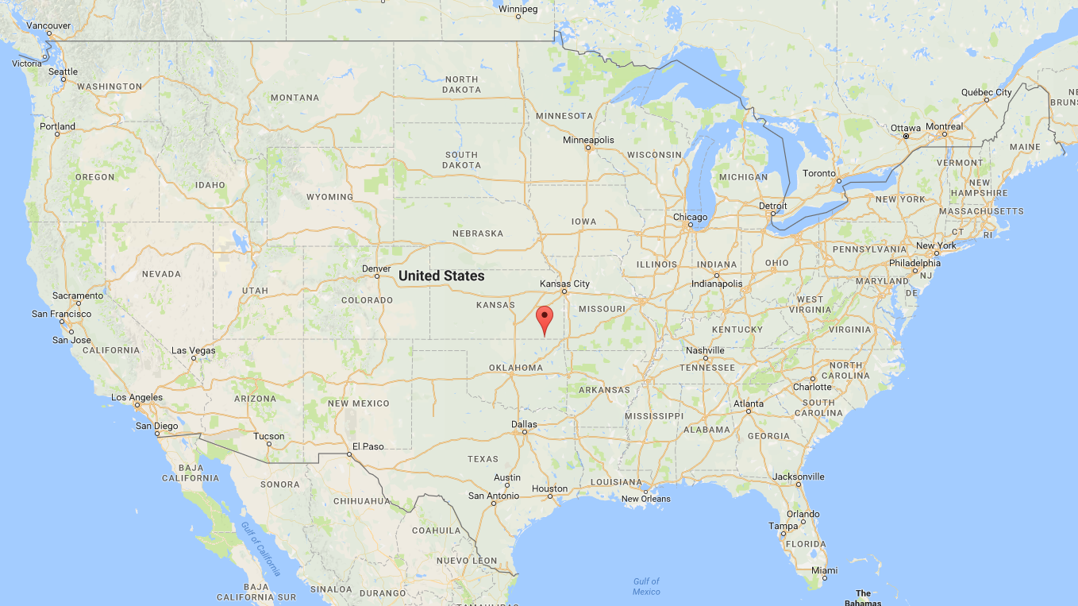
Geographic Distribution- History
2004
2006
2009
2012
2015
Puerto Rico

Slide 10
Geographic Distribution- Current
2012
2015
Puerto Rico

Slide 11
Geographic Distribution- Partners
2012
2015
prem-dmr.org
Puerto Rico

Slide 12
Statistics
New vs Renewal
# of Awards
Type of MSI

Slide 13
Cumulative Graduates and Scientific Output
Class | 2004 | 2006 | 2009 | 2012 | 2015 | Totals
Postdocs | 9 | 28 | 36 | 22 | 2 | 97
Grad Students | 61 | 103 | 98 | 83 | 10 | 355
Undergrads | 115 | 143 | 230 | 128 | 33 | 649
Pubs | 282 | 357 | 449 | 477 | 99 | 1664
Presentations | 862 | 766 | 1064 | 1113 | 275 | 4093
Patents (granted) | 0 | 0 | 3 | 2 | 0 | 5
Patents (pending) | 0 | 7 | 10 | 8 | 3 | 28

Slide 14
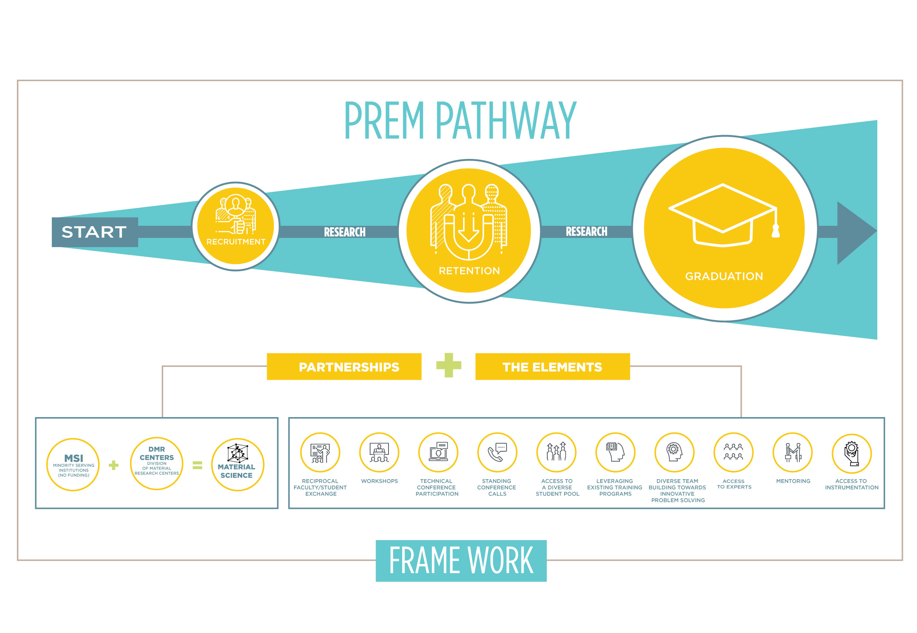
Solicitation 17-599
The PREM framework provides opportunities to all participants to contribute to some/all components of the PREM Pathway, focusing on different elements according to their research capacities.

Slide 15


Wide Range of Starting Research and Education Capacities
Successful PREMs are site-specific can be designed within a variety of starting research and education capacities through:
Identifying the Starting Point
Designing an End Point – both are conducive to evaluation
Anticipating the obstacles along the segment of the pathway they are tackling and proactively addressing them
Credit:Hackshaven/Flickr
Credit: CCAC North Library/Flickr
Notes:
Site-specific: hence the diversified research capacity within the portfolio

Slide 16
Program Description
Engage in compelling scientific materials research
Promote increased diversity along the PREM pathway
Propose either existing or newly designed elements in the framework at both partnering institutions:
  diversity efforts
  research output in materials research
Provide metrics: PREM partners should propose specific metrics under which the partnership will be evaluated.
Specify gains: Each partner must specify anticipated gains both in increased diversity and research output.
Establish reciprocity: Reciprocal faculty and student exchanges are a core component of the partnership.
Notes:
Promote increased diversity along the PREM pathway covering all or a segment of the recruitment/retention/degree-attaining sequence through intentional opportunities (i.e. the elements in the framework) through scientific learning, training and education.
Propose either existing or newly designed elements in the framework that will successfully promote inclusiveness and research excellence by increasing at both partnering institutions:

Slide 17


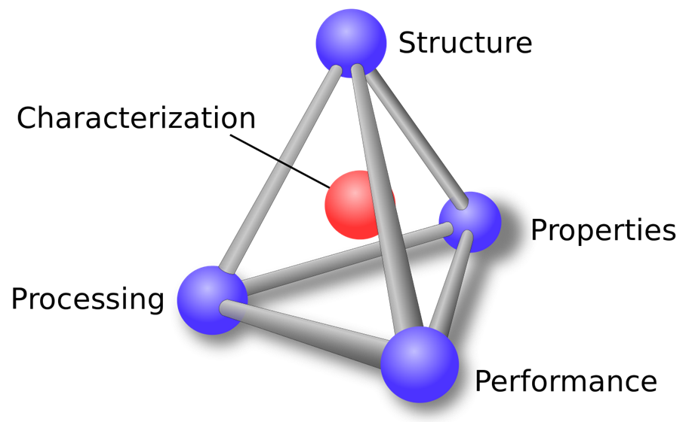
P is for Partnership
PREM partnerships present an opportunity for advancement for both partners in diversity and research capacity. In this section, the starting point of each institution must be described in terms of diversity and research capacity for all partners involved.
The partnership context will be used as the base line in Project Assessment and Evaluation.
Credit:Wikipedia
Notes:
Diverse landscape of MSI in research capacity and also of possible partners: MRSECs and DMR-funded facilities.
Reciprocity-
the partnership is expected to complete a segment of the PREM pathway within the duration of the award that is commensurate with the partnership’s starting research and capacity levels. The vision of the partnership, however, must include an intentional effort that foresees the full completion of the pathway; even if this is to be accomplished through sequential interventions in subsequent awards.

Slide 18
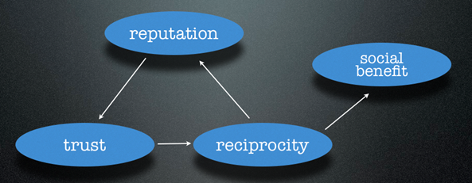

P is for Partnership
The PREM pathway towards diversity needs to be described for each partnership.
A clear and concise vision of the proposed partnership within the framework, needs to be provided by describing its overall research and education goals, along with the diversity objectives.
Credit:Wikndley/Flickr

Slide 19
Notes:
Methodology – Introducing the PREM FRAMEWORK: a schematic allowing to describe all PREMs, regarding of their starting point, i.e. the research capacity and diversity efforts.

Slide 20

The PREM Pathway maps the evolution of diversity efforts.
Each Partnership context is defined by an initial point along the Pathway.

Slide 21
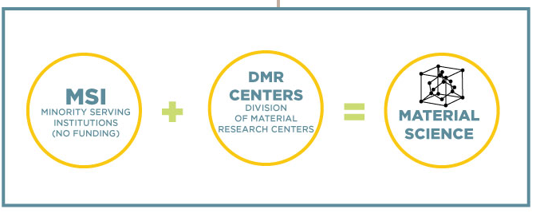
The Partnership
The Partnership is formed by MSI and DMR Centers and Facilities.

Slide 22
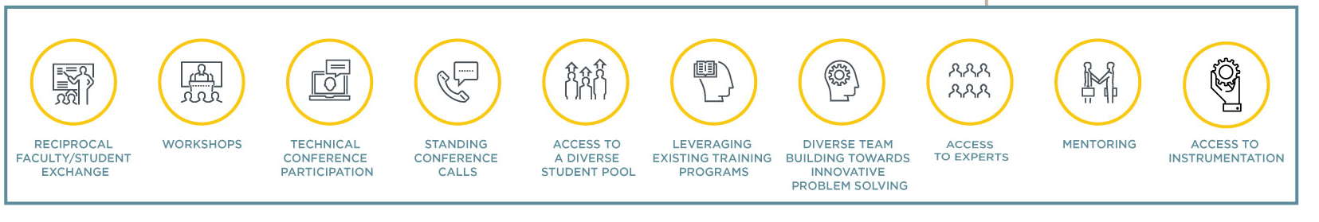
The Elements
The Partnership designs adequate research and education Elements to propel participants through the Pathway.

Slide 23

Who May Participate
Colleges and universities eligible to participate in this activity must be accredited and award degrees in materials-related disciplines and belong to, at least, one of the following classifications as Minority Serving Institutions (MSI):
1. Alaska Native Serving Institutions (ANSI)
2. Hispanic Serving Institutions (HSI)
3. Historically Black Colleges and Universities (HBCU)
4. Native Hawaiian Serving Institutions (NHSI)
5. Native American-serving, non-Tribal Institutions and Tribal Colleges and Universities (TCU)
6. Other Minority Serving Institutions (MSI)
Notes:
Eligible Academic Institutions
PREM proposals may be submitted by Institutions of Higher Education (IHEs) that primarily serve underrepresented groups in STEM.
Each PREM proposal must be submitted in partnership with one or more DMR-supported centers and /or facilities.
The proposal typically includes a subaward to the DMR supported center and/or facility, consistent with the proposed partnership activities.
Other Minority Serving Institutions (MSI) - Accredited IHEs that award bachelor level degrees that have an aggregate undergraduate enrollment of American Indian, Alaska Native, Black, Hispanic, and Pacific Islander exceeding 50 percent of total undergraduate enrollment.
Note that 2-year and 4-year Associate degree-granting colleges are not eligible to submit a proposal under this solicitation, except where an established degree-granting partnership exists with an eligible institution. However, a 2-year and 4-year Associate degree-granting college may partner with a leading Minority Serving Institution (MSI).

Slide 24
Eligible Partners
DMR-supported centers and facilities:
1. Materials Research Science and Engineering Centers (MRSEC). https://mrsec.org
2. Science and Technology Centers (STC). http://ciqm.harvard.edu) and http://strobe.colorado.edu).
3. Materials Innovation Platforms (MIP). http://www.mri.psu.edu/mip) and https://paradim.cornell.edu/
4. National High Magnetic Field Laboratory (NHMFL). (https://nationalmaglab.org/
5. Cornell High Energy Synchrotron Source (CHESS). http://www.chess.cornell.edu
6. Center for High Resolution Neutron Scattering (CHRNS). (https://www.ncnr.nist.gov/programs/CHRNS/
Notes:
Science and Technology Centers (STC). DMR currently supports two STCs: Center for Integrated Quantum Materials (CIQM) (see http://ciqm.harvard.edu) and Center on Real-Time Functional Imaging (STROBE) (see http://strobe.colorado.edu).
Materials Innovation Platforms (MIP). DMR currently supports two MIPs: 2D Crystal Consortium, Materials Innovation Platform (2DCC-MIP) (see http://www.mri.psu.edu/mip) and Platform for the Accelerated Realization, Analysis, and Discovery of Interface Materials (PARADIM) (see https://paradim.cornell.edu/)

Slide 25
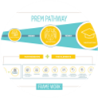
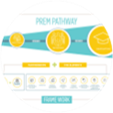
Vision of the Partnership
Proposals must emphasize the plan to form a partnership where recruitment, retention, and degree attainment of students from minority/underrepresented groups (i.e. the PREM pathway) can be achieved and monitored
Given the diversity of starting points for any given partnership, proposals must describe their current status in the recruitment/retention/degree attainment paradigm. In addition, partnerships should identify the challenges associated to each step in the sequence.
Proposals must provide a description of the long-term research goals and intellectual focus of the partnership, and describe the planned activities in sufficient detail to enable assessment of their scientific merit
Partners common intellectual interests are either pre-existing or newly identified.
The proposed strategy to propel participants through the PREM pathway assemble pre-existing or newly developed research and education elements in the framework.
Each PREM partnership should define progress in the recruitment/retention/degree attainment sequence within the PREM pathway to enable a continuous evaluation of the project. Metrics have to be defined by the partnership
The PREM program is designed to bring benefits on diversity and research output to both partners. These benefits have to be clearly identified
Notes:
The goal of PREM is to increase diversity in STEM disciplines.
Metrics: the expectation is an increase in the research capacity parameters

Slide 26
Examples of Success in PREM
Starting research and capacity levels of the partnership determine the starting point of the partnership.
As a result of the developed strategies and proposed research and education elements, the position of the partnership on the PREM pathway will evolve.
To date, successful PREMs have:
Devised innovative strategies around recruitment, retention and degree attainment that have successfully promoted enrollment of minority students in STEM Ph.D. programs in both minority and non-minority serving institutions throughout the U.S.
Prepared undergraduates at the lead institution for recruitment by the partner institution; simultaneously increasing diversity in STEM areas and research output.
Notes:
In addition, successful PREMs have:
Published papers in prestigious journals, filed for patents and nucleated spin-off companies that were successfully purchased by multinationals, competed in National Science Fairs, graduated PhD students at non- MSI institutions, created brand-new MSE programs, participated in prestigious conferences, saw PhD students graduate and join the workforce- complete pathway…

Slide 27

A Word on Metrics
The importance of context: it sets up the criteria for evaluation.
A variety of initial contexts in terms of research capacity and position on the Pathway can lead to very successful PREMs:
  UT El Paso
  UPR Humacao
An initial description in the proposal will be further refined upon award.
Questions to consider:
  Where are we now?
  How can we contribute to the Pathway?
  Where are we going to be in 6 years?
  How are we going to get there?
Notes:
Metrics are site specific

Slide 28
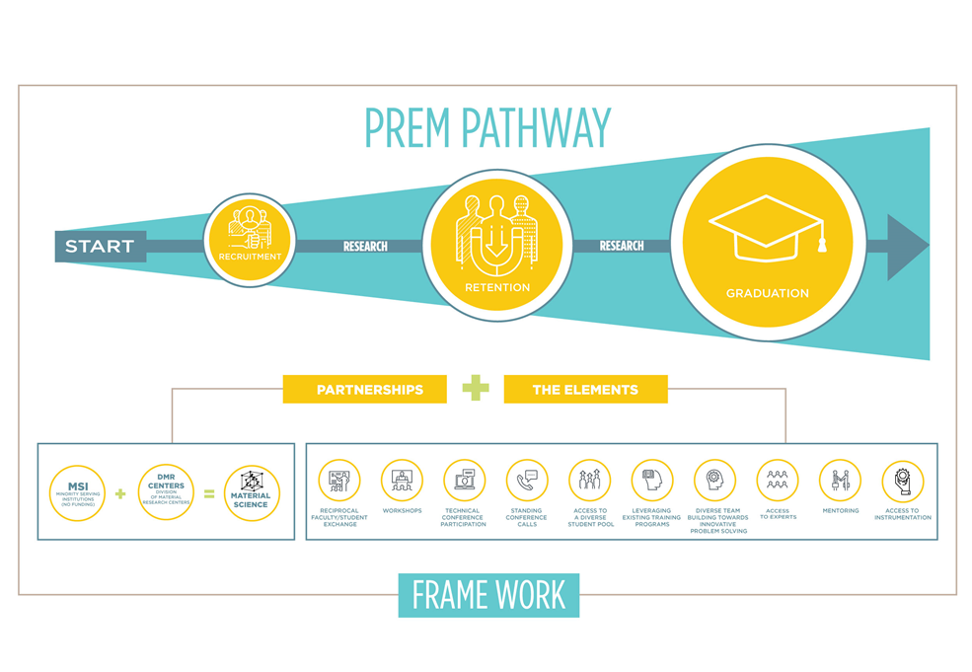
Successful Frameworks:
PREM Pathway, Partnership and Elements
  Recruitment: New Mexico Highlands University, PI Tatiana Timofeeva
  Retention: University of Texas Rio Grande Valley, PI Karen Lozano
  Recruitment and Retention: California State University, PI Gang Lu
  The whole Pathway: University of Texas El Paso, PI Luis Echegoyen
Notes:
HAVE THE HIGHLIGHTS OF THEIR PREMS AS BULLET POINTS

Slide 29



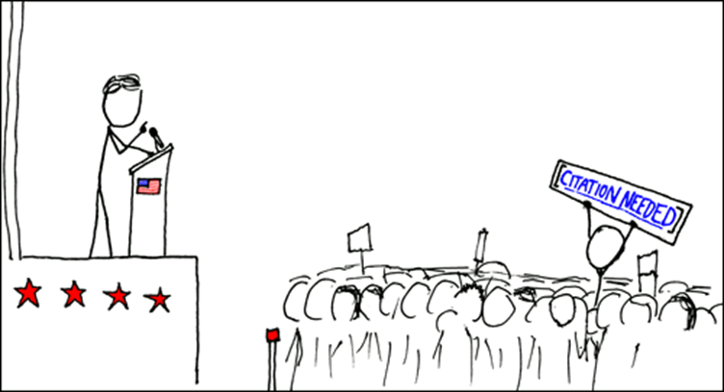
The Expectation and Outcome of a PREM Award
Diversity
+
Scientific Output
Expectation: Increase diversity through Materials Research.
Outcome: Increased diversity and research & education output.
Notes:
Metrics: the expectation is an increase in the research capacity parameters
Project assessment and evaluation is partnership-specific and should emphasize increase in both diversity and research and education quality and quantity measured relative to the beginning of the award.

Slide 30
NSF Contacts
General inquiries regarding this program should be made to:
Eva Campo, telephone: (703) 292-7010, email: ecampo@nsf.gov
Full solicitation details:
https://www.nsf.gov/funding/pgm_summ.jsp?pims_id=5439
More information about current PREM awards:
https://www.prem-dmr.org/
Information about DMR:
https://www.nsf.gov/div/index.jsp?div=DMR
For questions related to the use of FastLane, contact:
FastLane Help Desk, telephone: 1-800-673-6188; e-mail: fastlane@nsf.gov.
For questions relating to Grants.gov contact:
Grants.gov Contact Center: If the Authorized Organizational Representatives (AOR) has not received a confirmation message from Grants.gov within 48 hours of submission of application, please contact via telephone: 1-800-518-4726; e-mail: support@grants.gov
Notes:
-And Additional Resources

